Slide 1

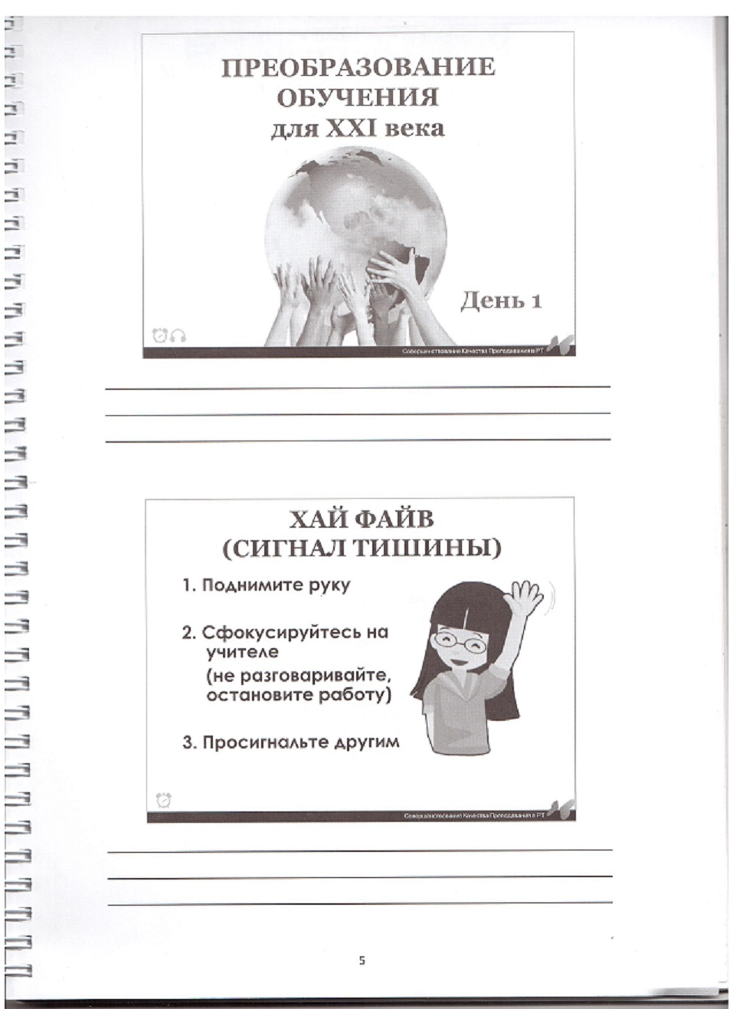
Hi five!

Slide 2
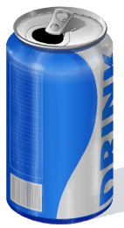
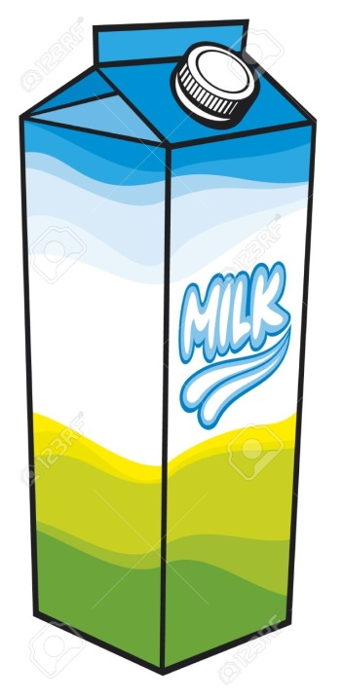
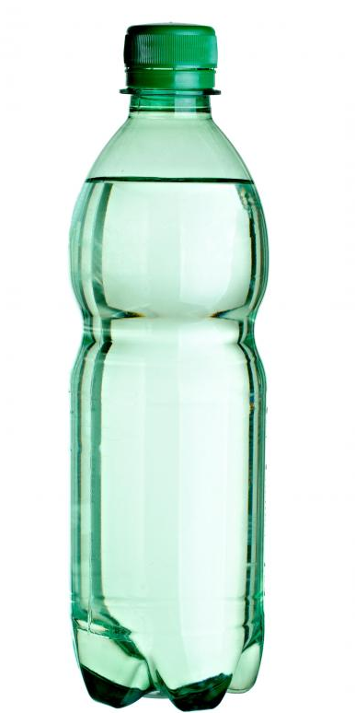
?

Slide 3
Containers

Slide 4
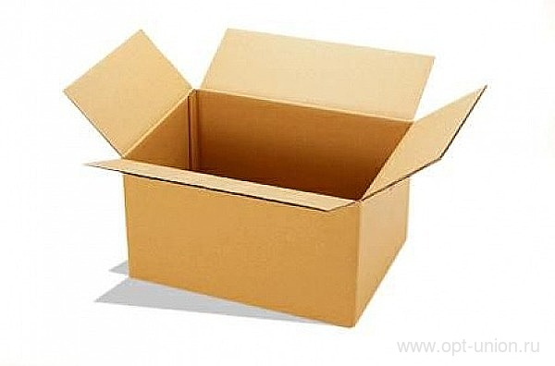
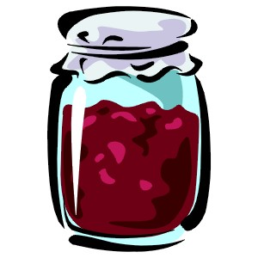

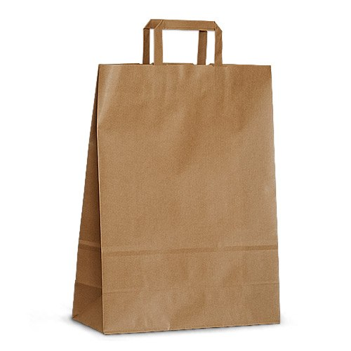
Containers

Slide 5
metal
cardboard
glass
Containers
and ?
plastic
aluminium
paper

Slide 6
metal
cardboard
glass
Containers
and materials
plastic
aluminium
paper

Slide 7
cardboard
paper

Slide 8
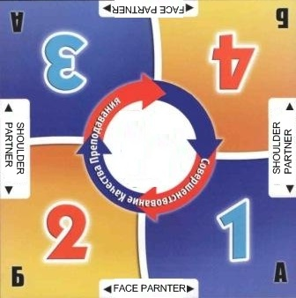
Simultaneous
Round Table
metal
glass
cardboard
Containers
and materials
aluminium
plastic
paper

Slide 9
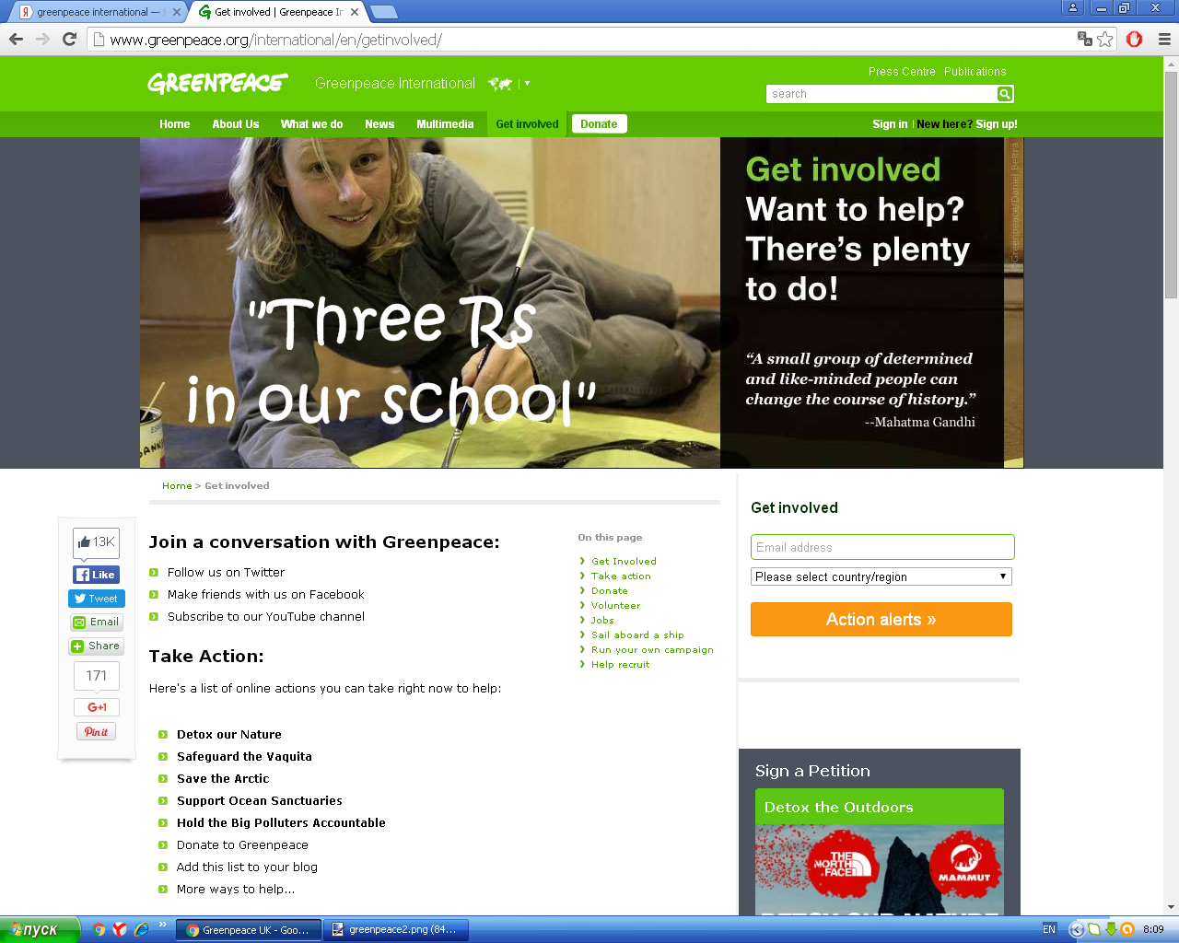

Slide 10
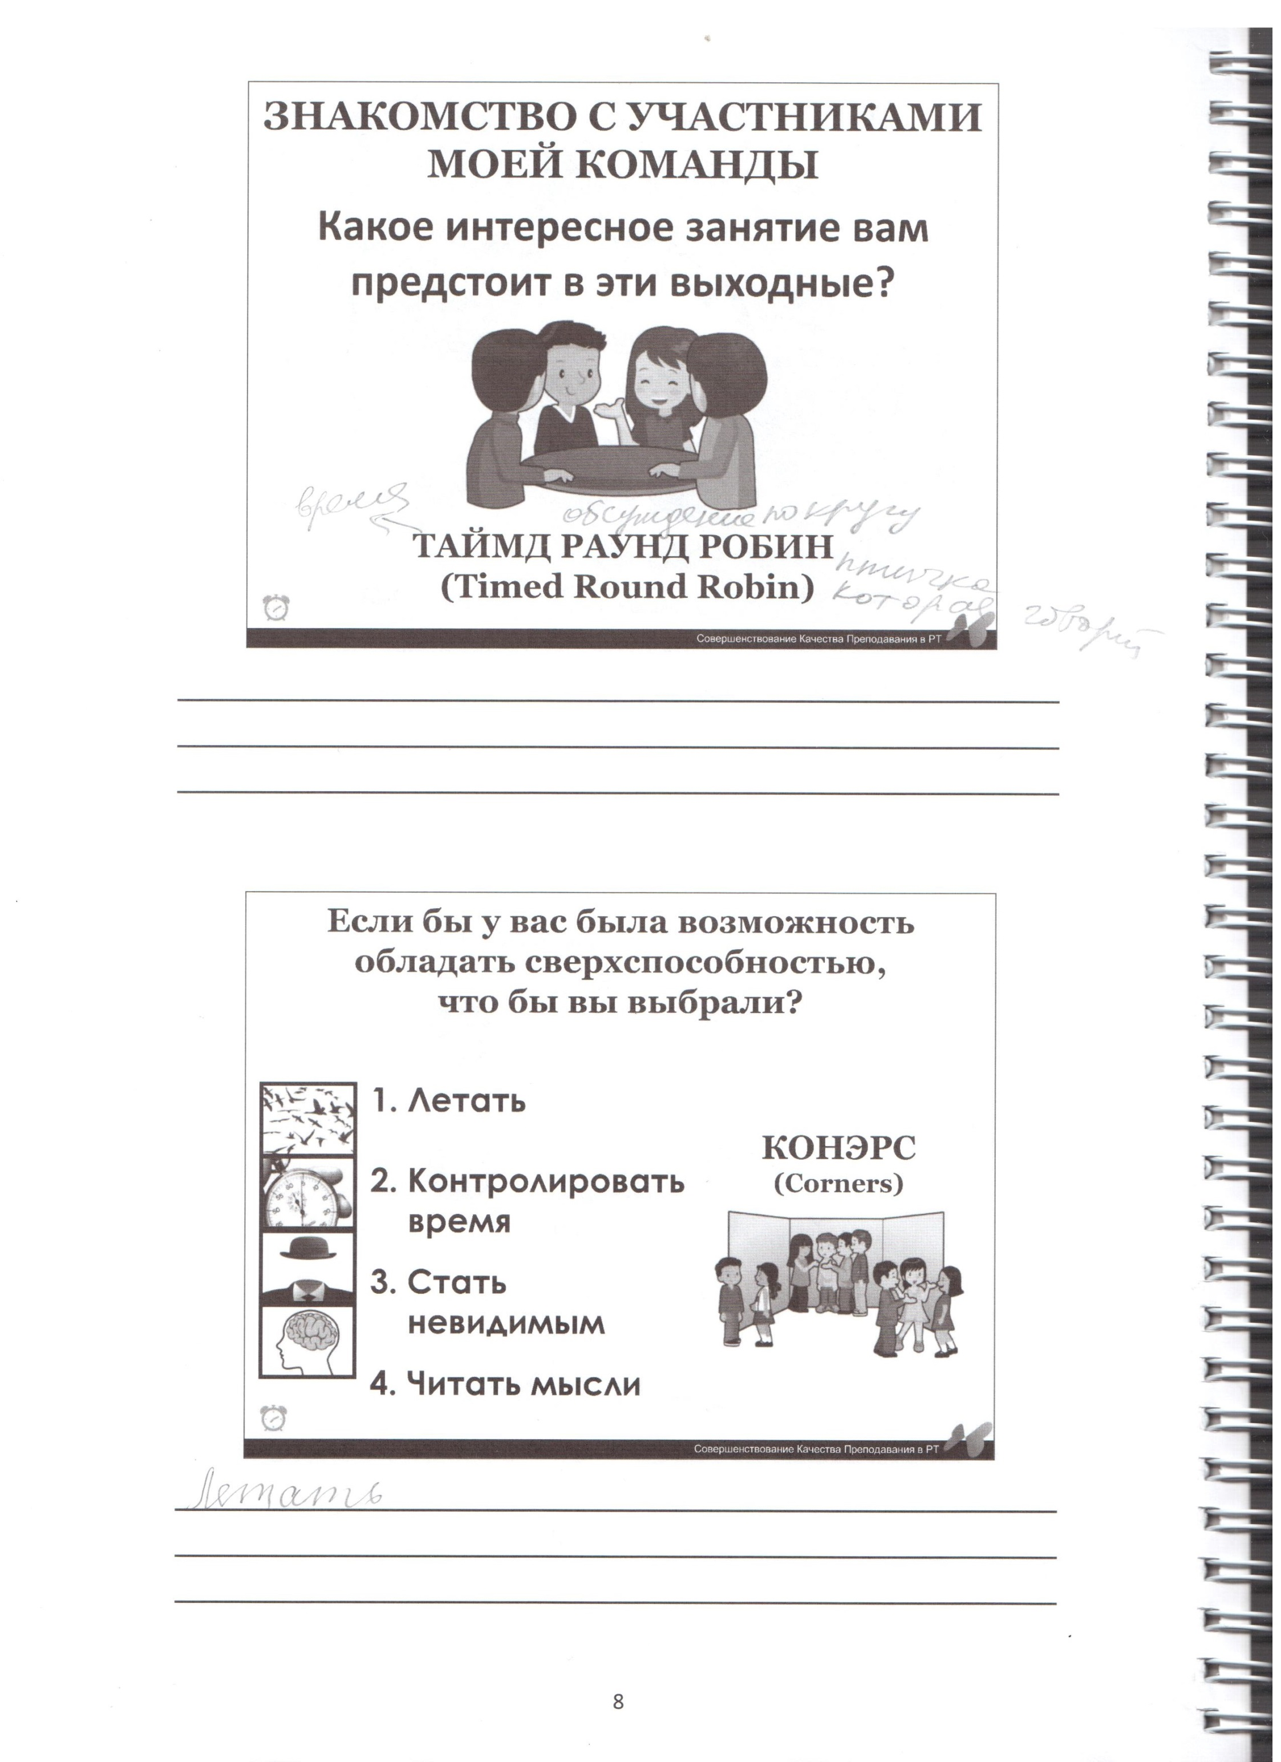
The Three Rs
Corners
R …
R …
R …
Reduce - уменьшить
Reuse – использовать
снова
Recycle - перерабатывать

Slide 11
True/false
To reduce the amount of waste you should buy extra things.
You can reuse old bags, jars and others.
If you have an old jar, you can make a container for pencils.
You should use four rubbish bins in your house.
Please put paper and glass in the same recycling box.

Slide 12

Corners
F
T
T
T
F

Slide 13
throw away/reuse/don`t/things/can/you/which/
Don`t throw away things
which you can reuse.

Slide 14
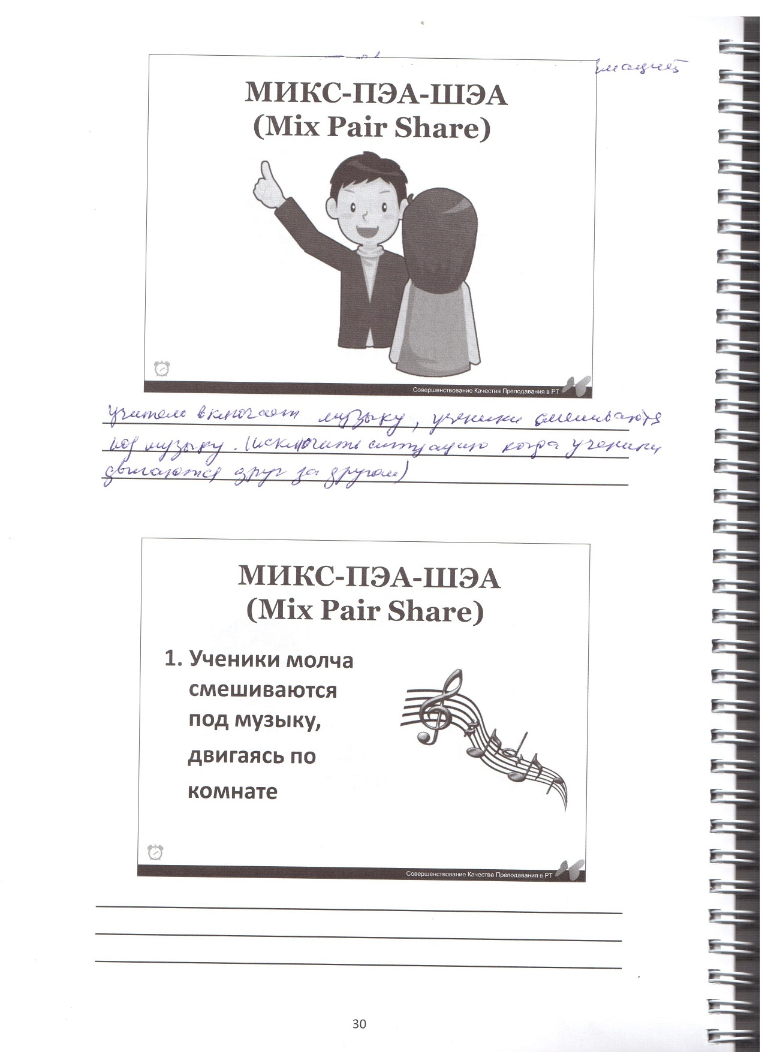
Mix Pair Share

Slide 15
aluminium
glass
cardboard
paper
plastic
metal

Slide 16
Put your rubbish in the bin.

Slide 17
First Conditional
If you throw away plastic, you will pollute the nature.
If you throw away plastic, you won`t save the nature.
You will pollute the nature if you throw away plastic.

Slide 18
Complete the sentences
If you eat healthy food, you … (feel) better.
If we ban plastic bags, we … (not use) them.
If turtles …(eat) plastic bags, they`ll die.
You will recycle containers if you …(want) to help our Planet.
People …(not save) the rivers if they pollute them.
will feel
won`t use
eat
want
won`t save

Slide 19
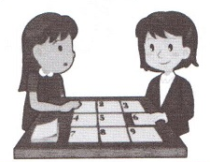
Tic Tac Toe
x | 0 | x
x | If | x
0 | 0 | 0

Slide 20
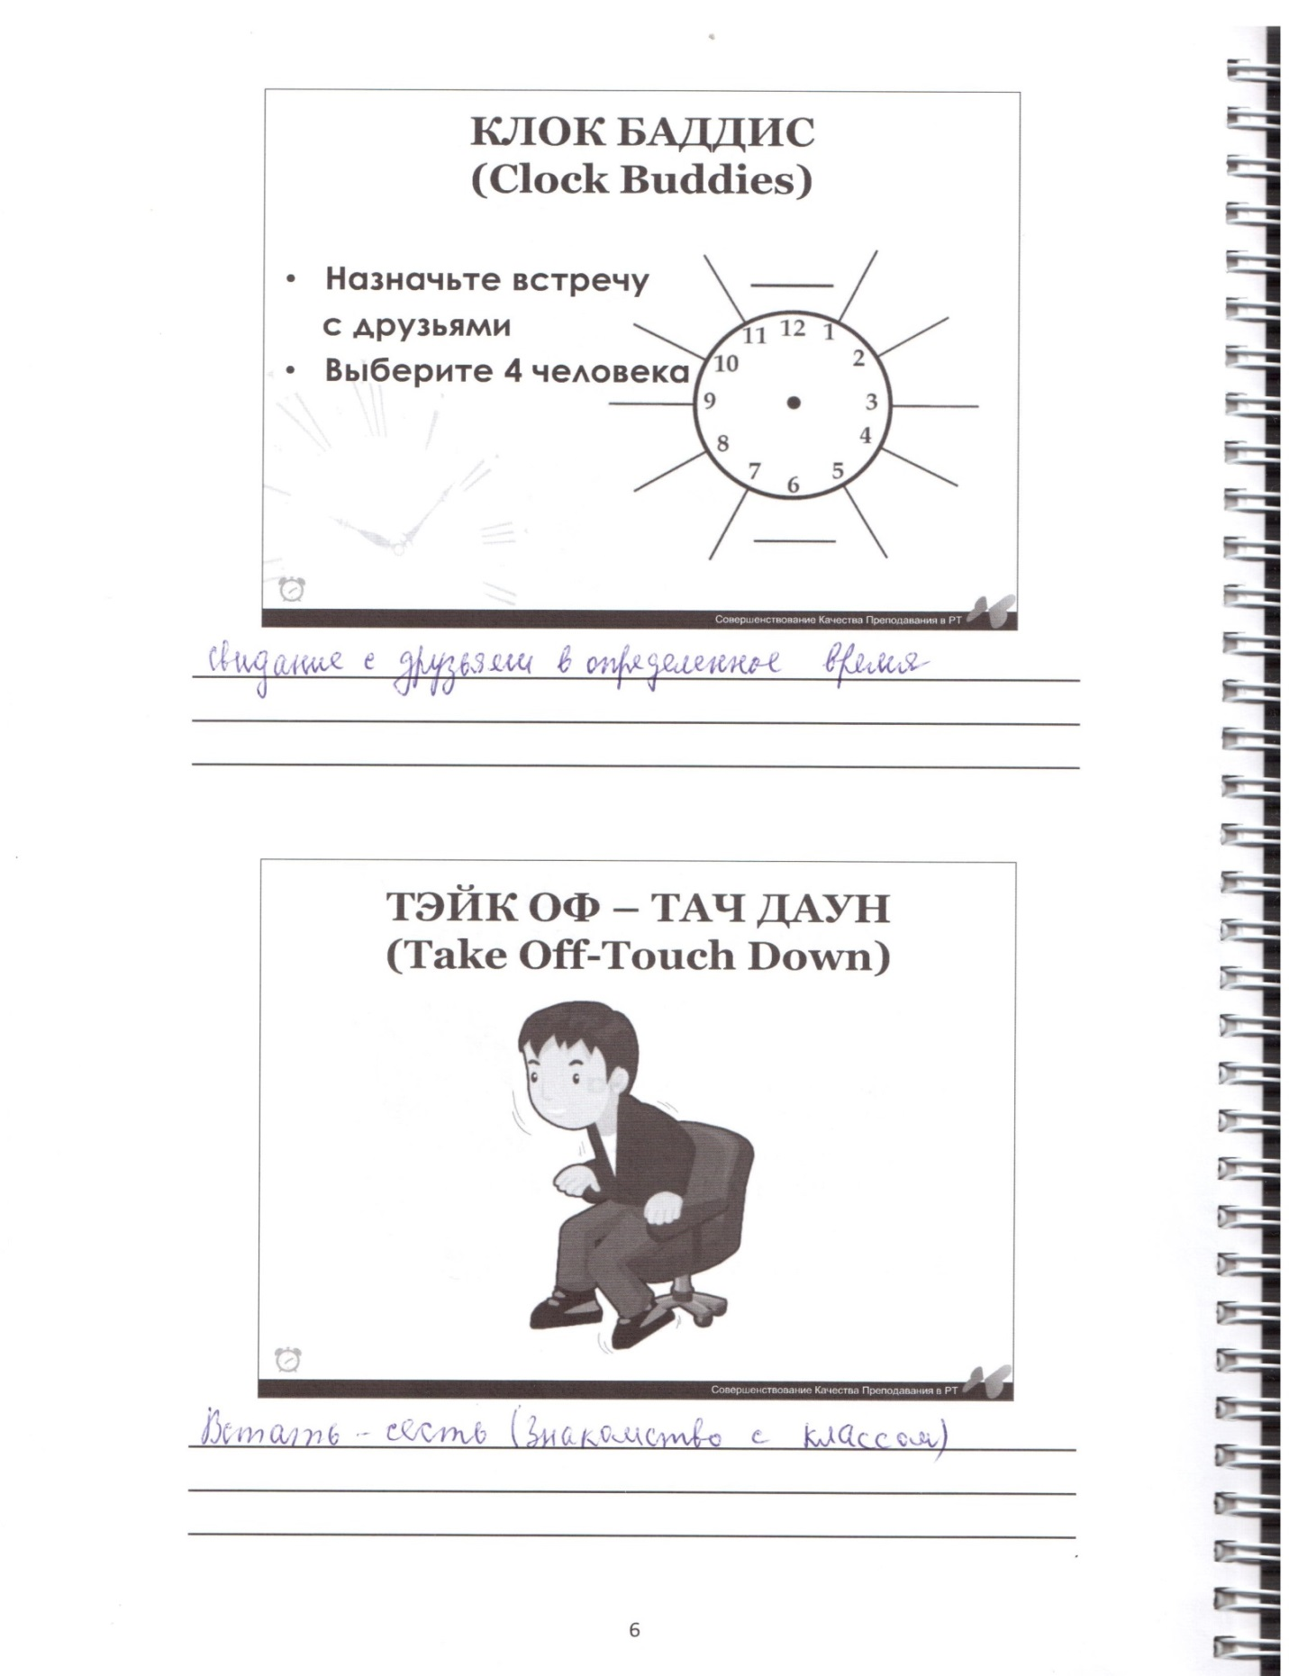
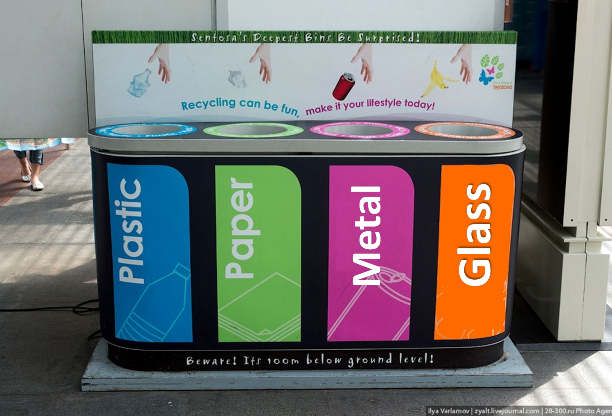
Take off –
Touch down

Slide 21
Match the parts of the sentences.
1d
If you want to throw plastic and glass, you won`t put them in the same bin.
2a
If you want to save our Planet, you won`t throw away a rubbish.
3e
If you have an old can, you will reuse it.

Slide 22
If you want to have a clean school,
you will draw or paint on the walls.
you won`t draw or paint on the walls.
you draw or paint on the walls.

Slide 23
Listening
“3”
“4”
“5”

Slide 24
Listening
“5”
cardboard
plastic
resident
Hawaii
turtles
“5” – 5 points
“4” – 4 points
“3” – 3 points
“2” – 2-0 points
“4”
F
T
T
F
F
“4” – 5 points
“3” – 4-3 points
“2”- 2-0 points
“3”
billions
plastic
documentaries
stop
“3” – 4-3 points
“2”- 2-0 points

Slide 25
Reduce …
the amounts of waste.

Slide 26
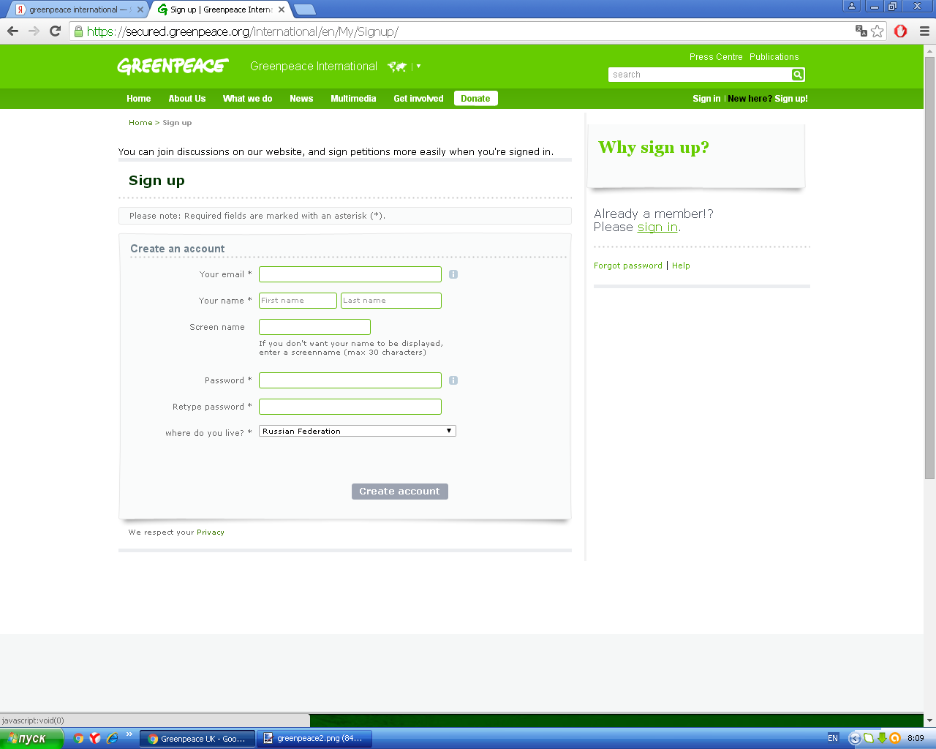

Slide 27
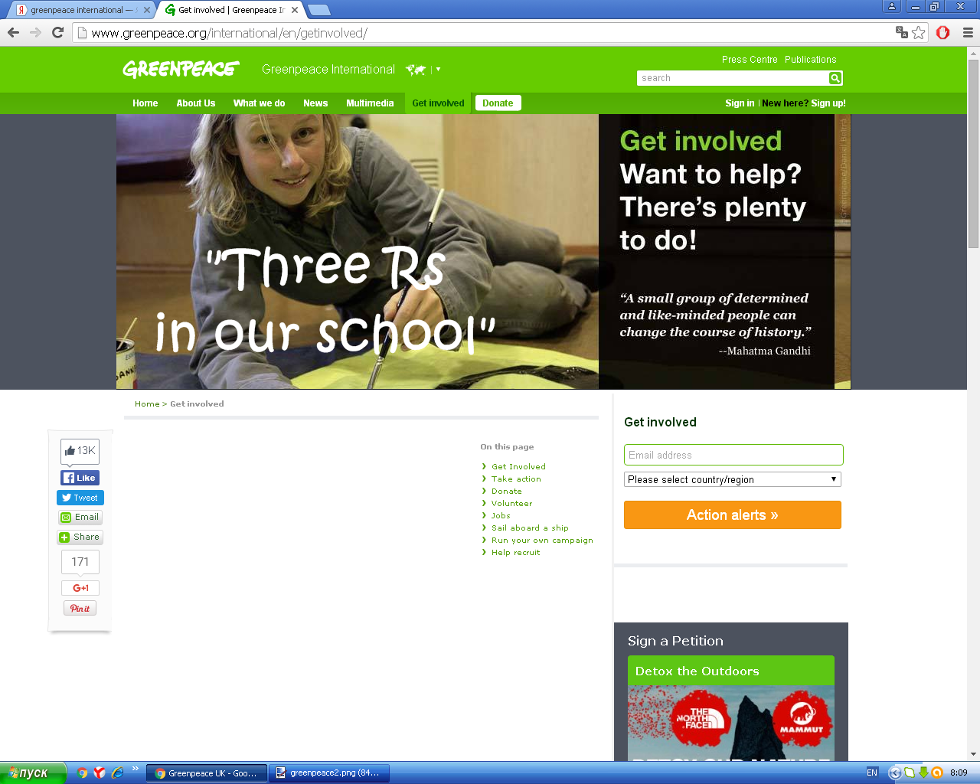

Rules ….
Don`t throw away things which
you can reuse.
Reduce the amounts of waste.
If you want to have a beautiful school,
you won`t draw or paint on the walls.
Put your rubbish in the bin.
Keep our school tidy!

Slide 28
Home task
Ex 3 p 94 answer the questions
Make signs for the rules
Make your own rules and signs. ***

Slide 29
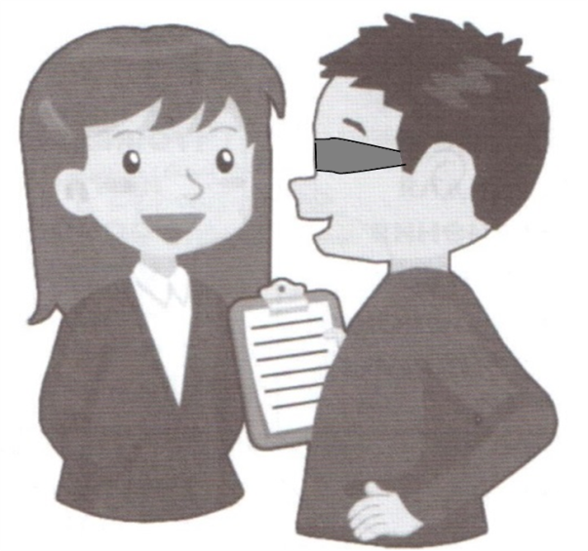
Blind Game
What is it?
What is it made of?
How can we use “Three Rs”?

Slide 30
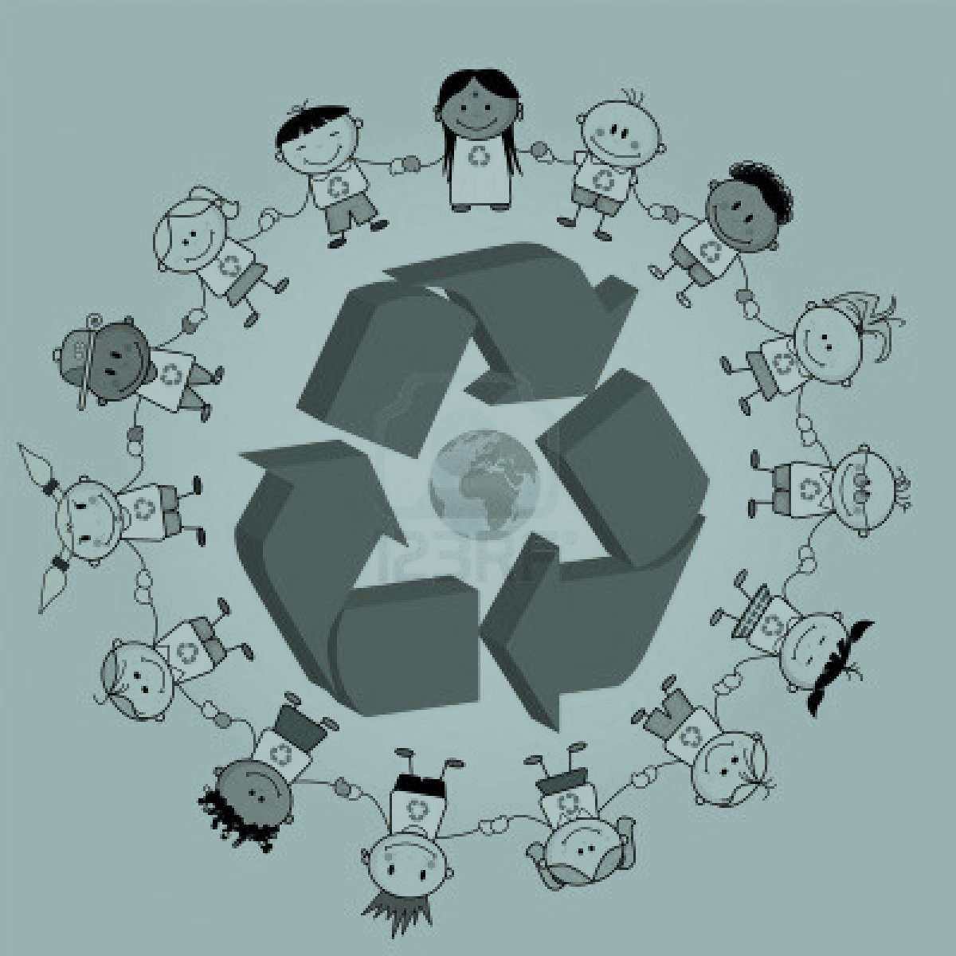
Inside-Outside Circle

Slide 31


